Slide 1
AUDIO TRANSFER USING RASPBERRY PI (REMOTELY)
ASHOK KUMAR M
ABISHEK K V

Slide 2
WHAT IS RASPBERRY PI: The Raspberry Pi is a low cost, credit-card sized computer that plugs into a computer monitor or TV, and uses a standard keyboard and mouse. It is Portable and Low cost SPECIFICATION: RAM: 1GB LPDDR2 (900 MHz). CPU: 4× ARM Cortex-A53, 1.2GHz. Ports: HDMI, 3.5mm analogue audio-video jack, 4× USB 2.0, Ethernet, Camera Serial Interface (CSI), Display Serial Interface (DSI)

Slide 3
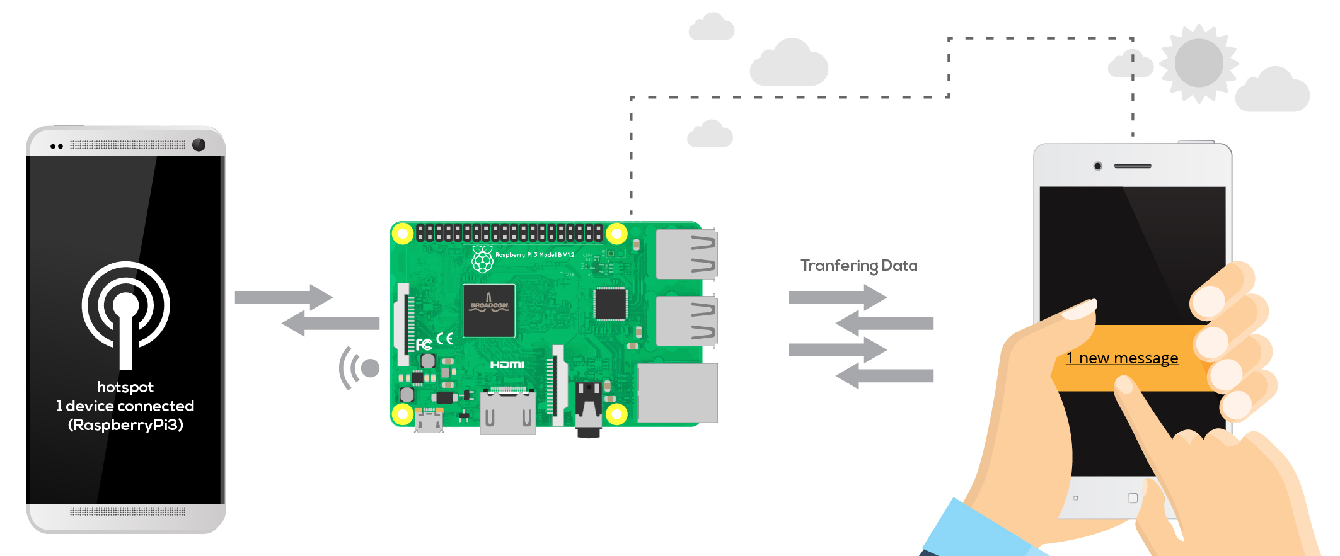
AUDIO TRANSFER USING RASPBERRRY PI: Raspberry is based on Python language Connect your mic with it Import Dropbox where we store our audio file Use HTML and PHP to access Remotely Create Database for storing the audio on/off state. Fetch these state in Python code.

Slide 4

DROPBOX: It is a free datastorage where we can access through mail and store data ( In our case we store audio) Now create a API (which is a software intermediary that allows two applications to talk to each other.) Create a folder to keep things organized. Now copy the API key and Folder path and paste it in the Python code for connecting Dropbox and Raspberry pi Your audio files are ready to go to Dropbox.

Slide 5
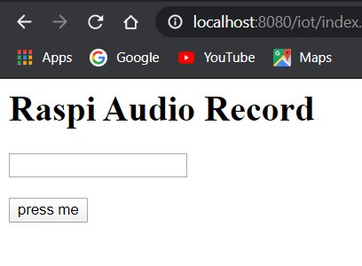

HTML AND PHP: For Remote access we need to include html , php and mysql HTML to get the on/off command from the user PHP to receive command from HTML and to store it in Database Then fetch the last status from the database and sends to python code ( Raspberry pi)

Slide 6
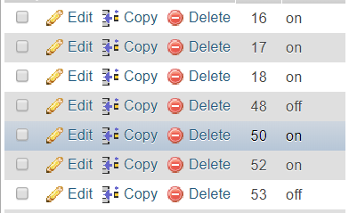
MYSQL DATABASE: Create a Database and table Store the on/off status in the Database Sort in descending order by which to fetch the latest state And we can store n number of data

Slide 7

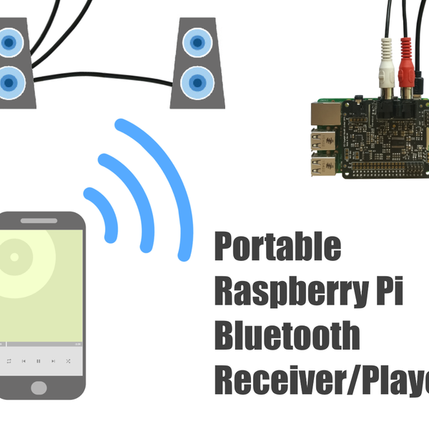
WORKING: upload php file in server or localhost Fetch the on/off status from database using in python connect to the Dropbox If the status is on, recording will start and recordings will upload in the dropbox If the status is off, recording won’t start And you can play the audio file at anywhere by just log into the dropbox

Slide 8
FURTHER IMPLEMENTATION: Further we are going to implement voice regonitionlike when we say ‘turn on’ recording it will turn on and if we say ‘turn off ‘ it will turn off And also access with google assistance, siri, and alexa, etc

Slide 9
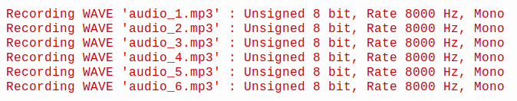
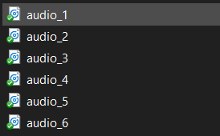
USES: Used for live transfer of audio where video recording is not permitted Used in the place where humans couldn’t able stay there By updating with voice recognition we can able to turn on or off using voice

Slide 10
THANK YOU

